Slide 1
Gradient Descent
D2L Sections 11.3-11.5

Slide 2
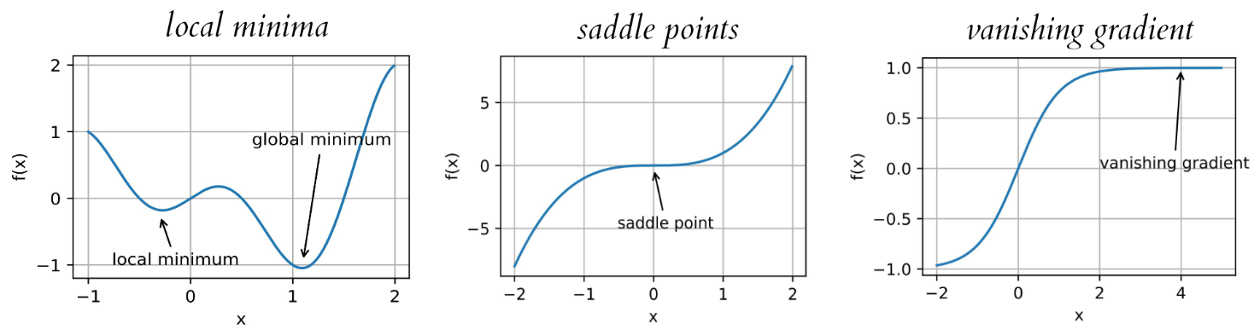
Review
Optimization important for reducing loss for a given model
Minimized loss can reveal effectiveness of model
Optimization algorithms are heavily affected by shape of loss function

Slide 3
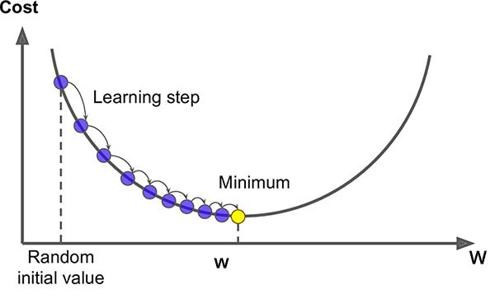





Gradient Descent
Start with Taylor expansion:
Choose a step size:
Choose a stop condition (magnitude of gradient, number of iterations)
Iterate x

Slide 4
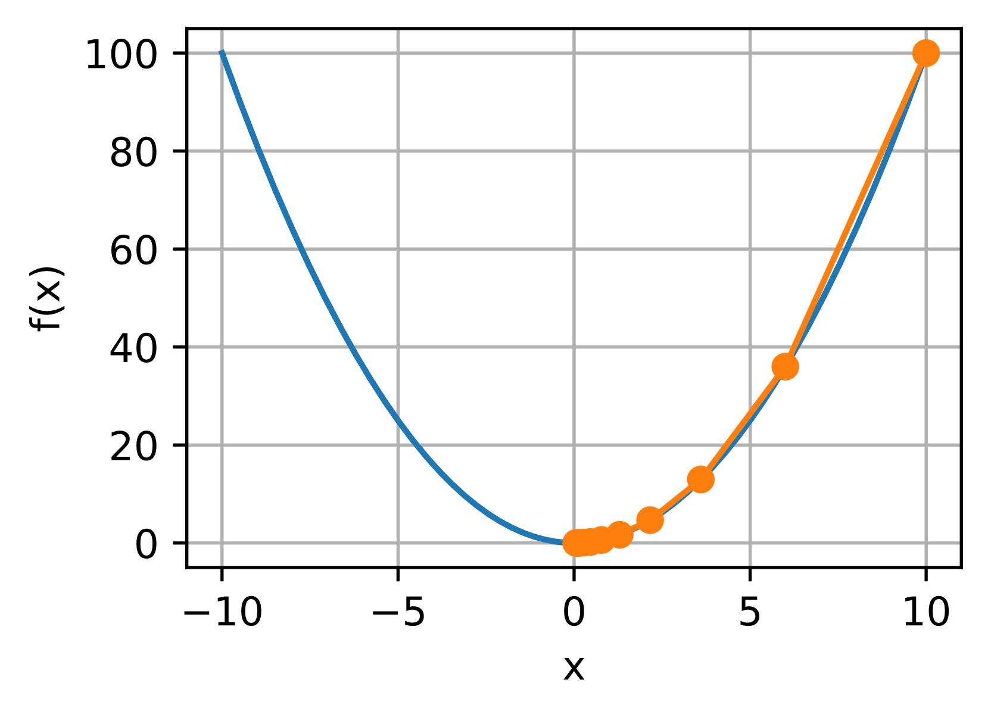
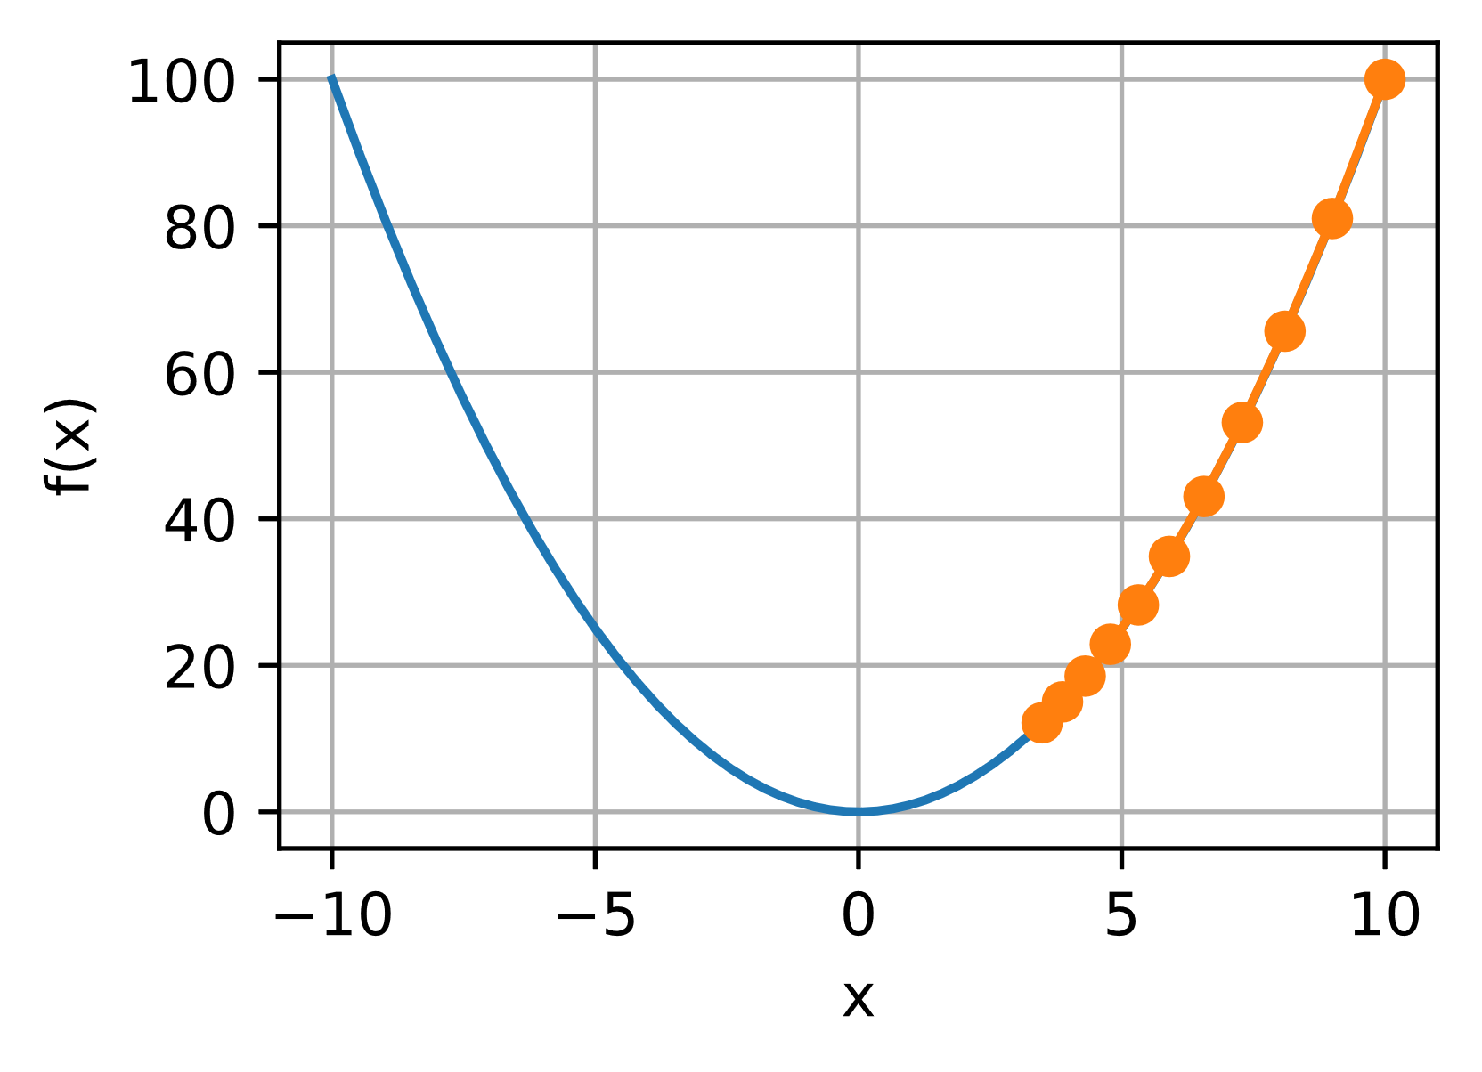
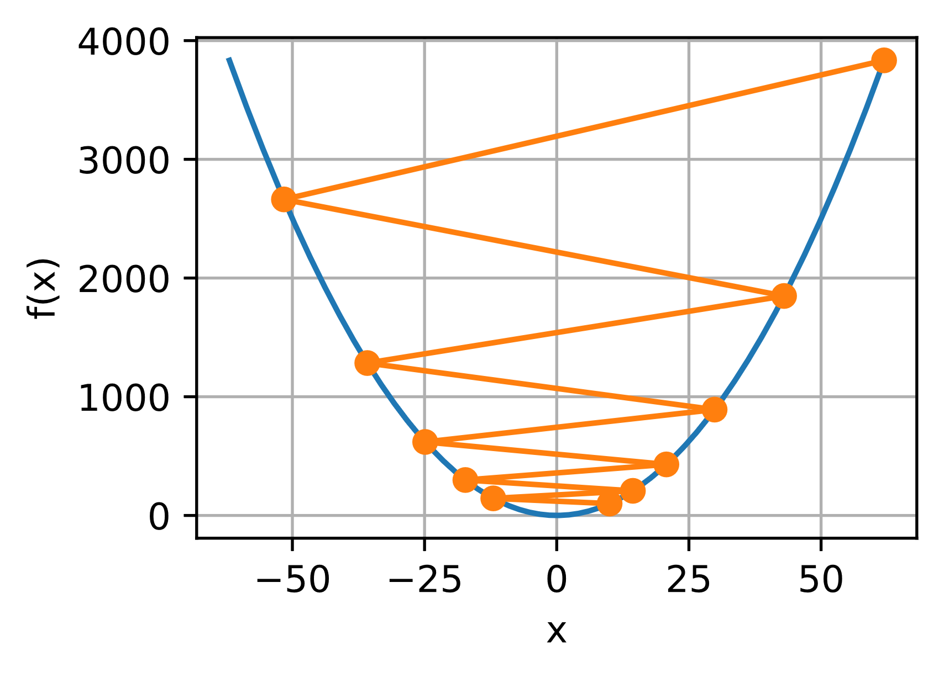
Choosing Learning Rate
Too small -
not computationally efficient
Too large –
overshoots and diverges

Slide 5
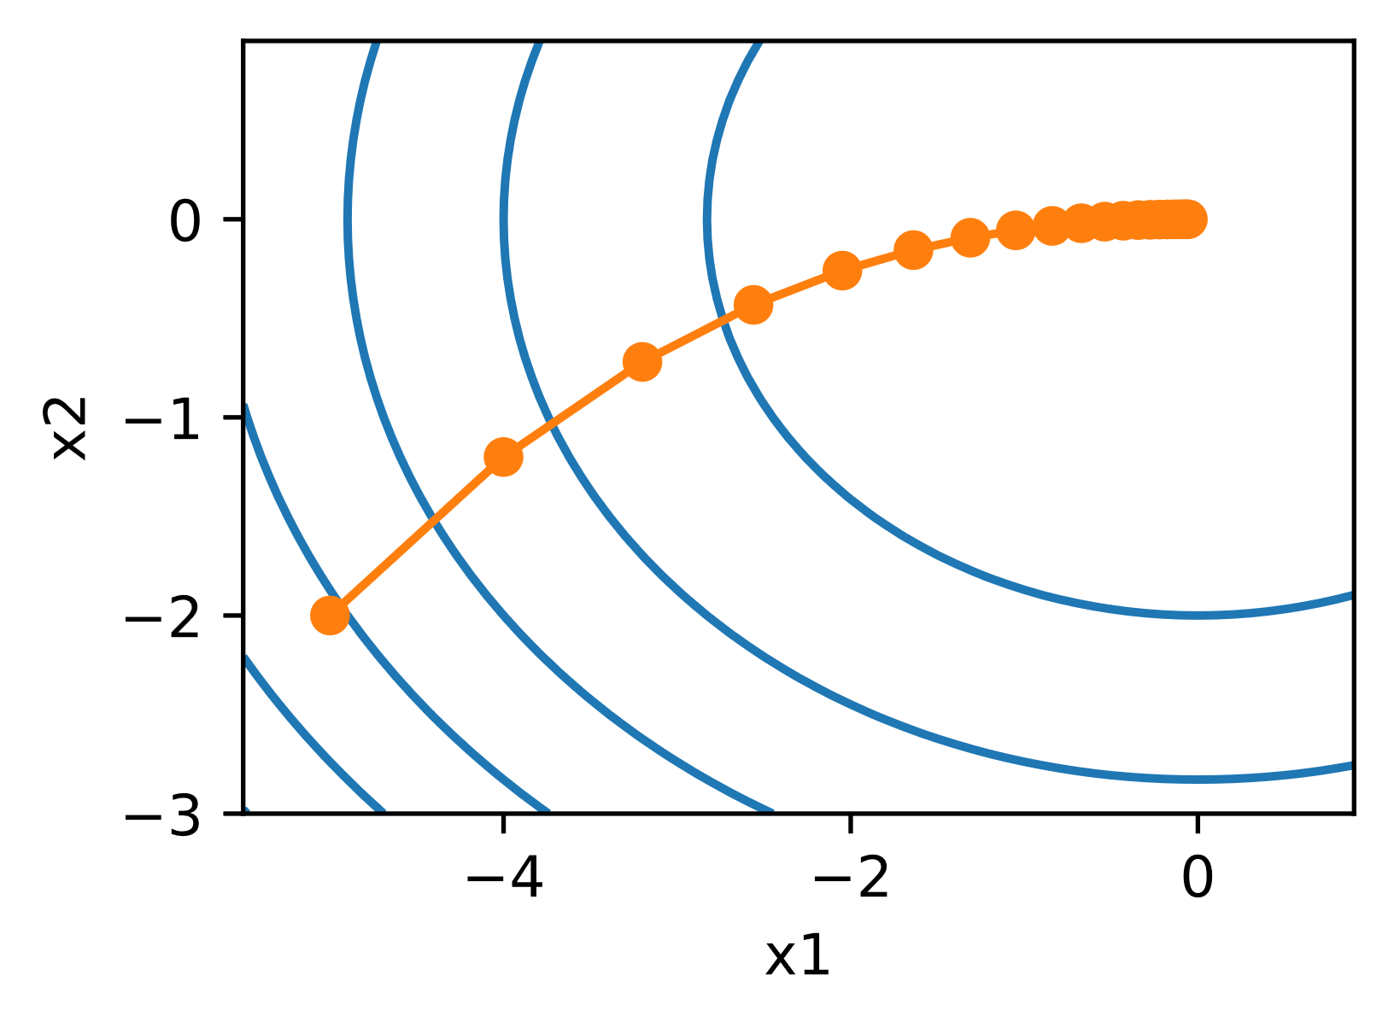


Multivariate Gradient Descent
Same principle as 1-dimensional
Key: iterating over entire data set, all parameters each time

Slide 6
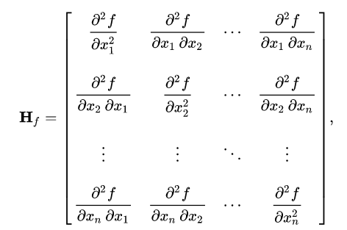


Newton’s Method
Adjusts learning rate based on curvature of objective function
  Looks for zero points in the derivative of the loss function
Computationally expensive, but a good guideline
Start with a Taylor Expansion:
Define a Hessian Matrix

Slide 7
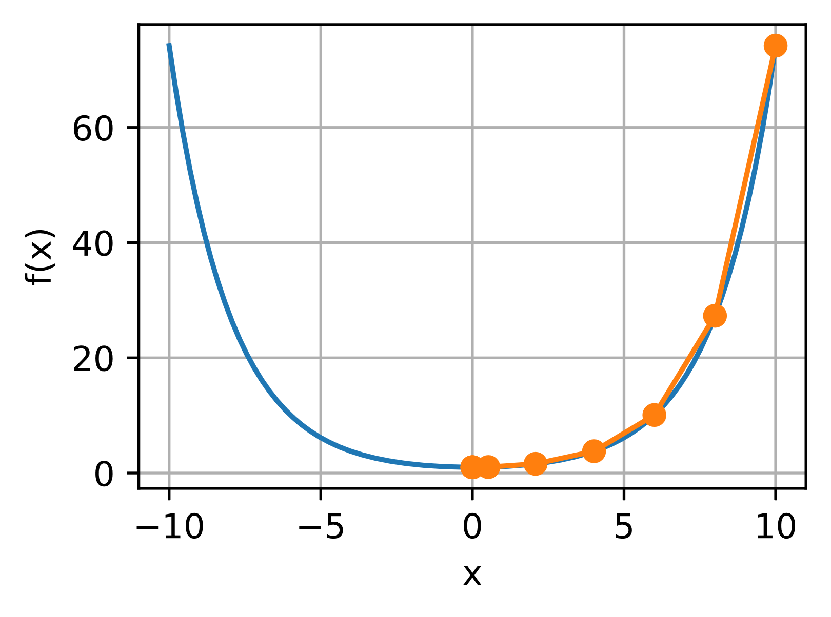
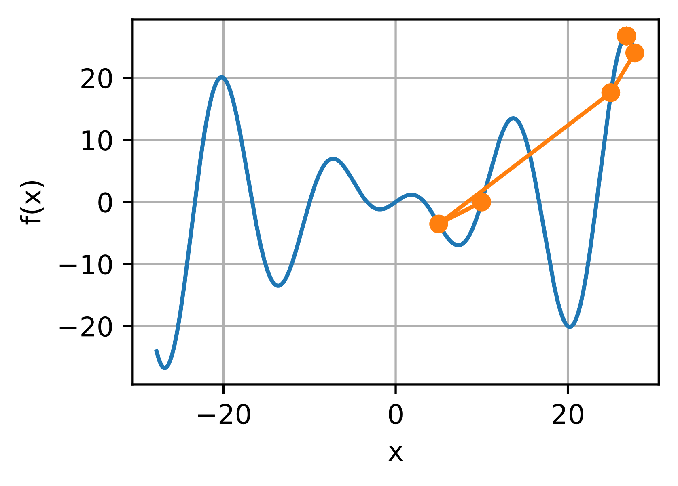
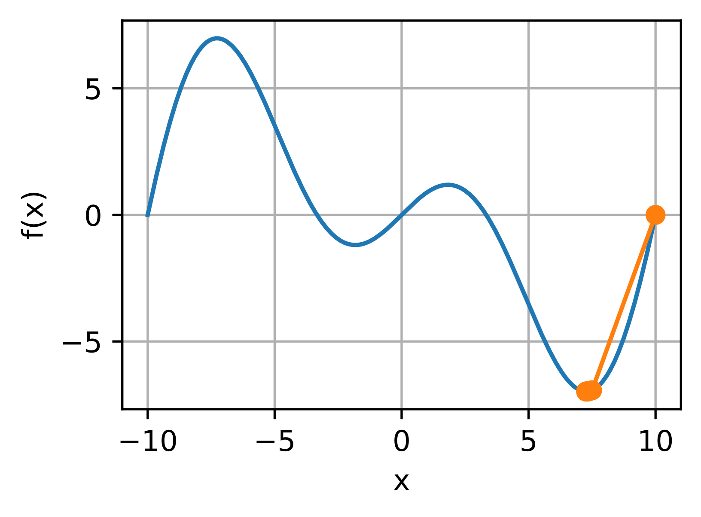
Newton’s Method
Looking for zero points in the derivative of the loss function
Works on convex and non-convex functions

Slide 8
Preconditioning
Full Hessian matrix is large, computationally expensive
Can just compute diagonal entries
Essentially chooses a different learning rate for each parameter

Slide 9
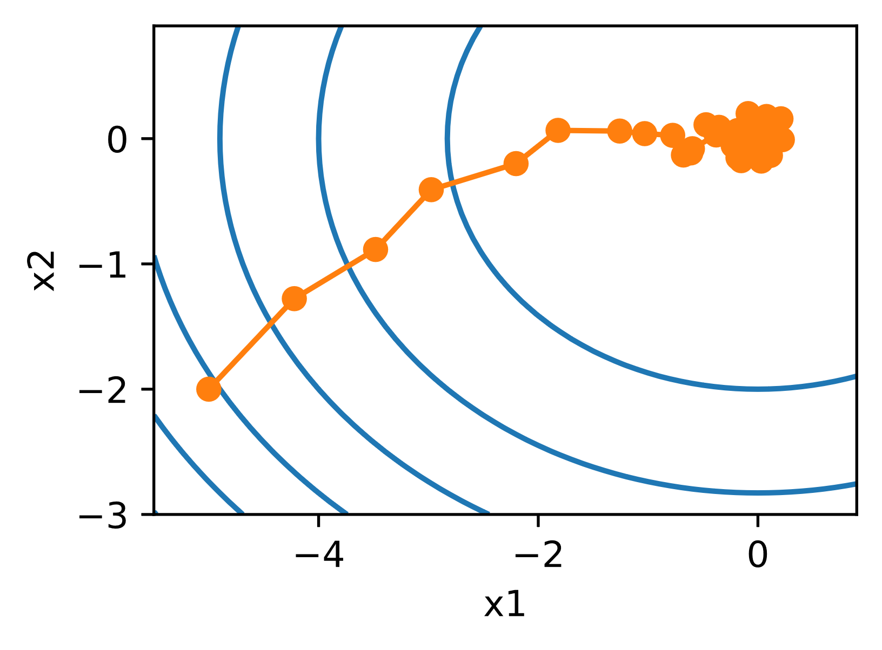

Stochastic Gradient Descent
Objective function = average of individual loss functions
Full batch - calculating gradient for each iteration goes as O(n)
  If no parallelization
SGD randomly samples data set at a single index to calculate gradient
  Now goes as O(1)
  Updates model at every step

Slide 10
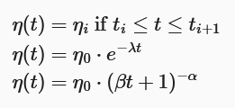
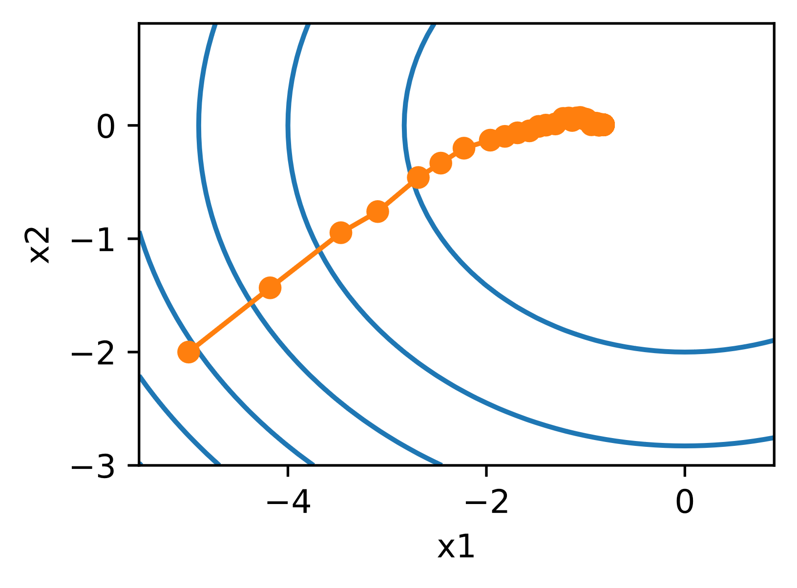
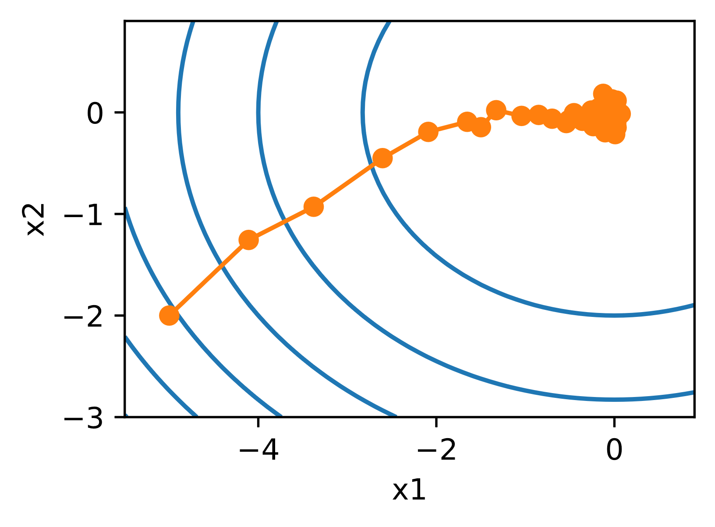
Dynamic Learning Rate
Allows learning rate to evolve with progress
Piecewise constant
Exponential Decay
Polynomial Decay

Slide 11
Minibatches
Generally, GD not data efficient and SGD not computationally efficient
Minibatches takes advantage of vectorization and computer architecture
Randomly divides entire training set into smaller batches and runs in parallel
  Each batch is unique combination of sample

Slide 12
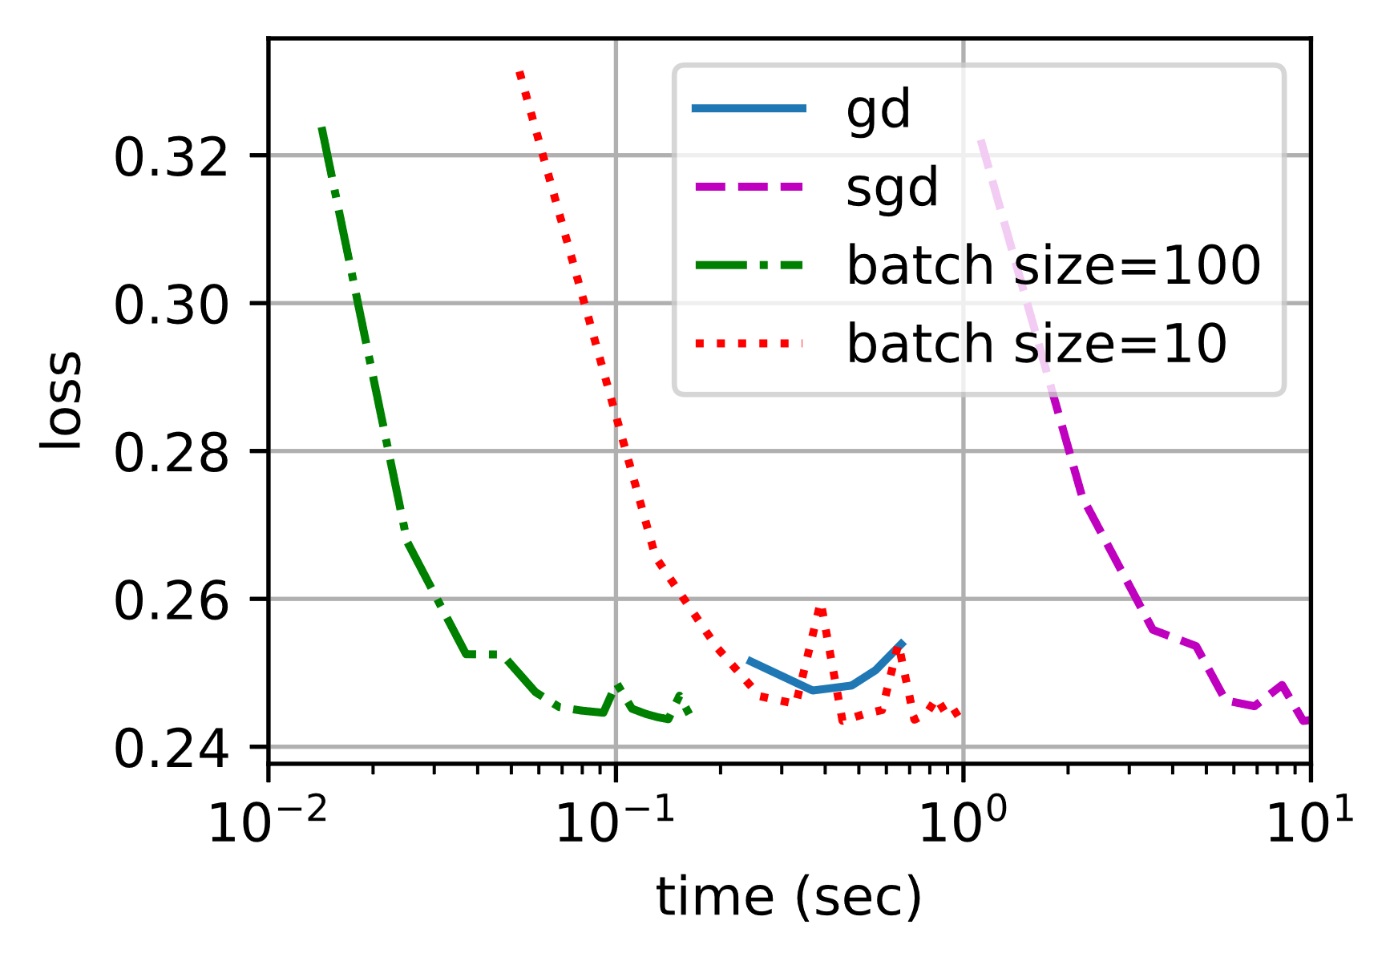
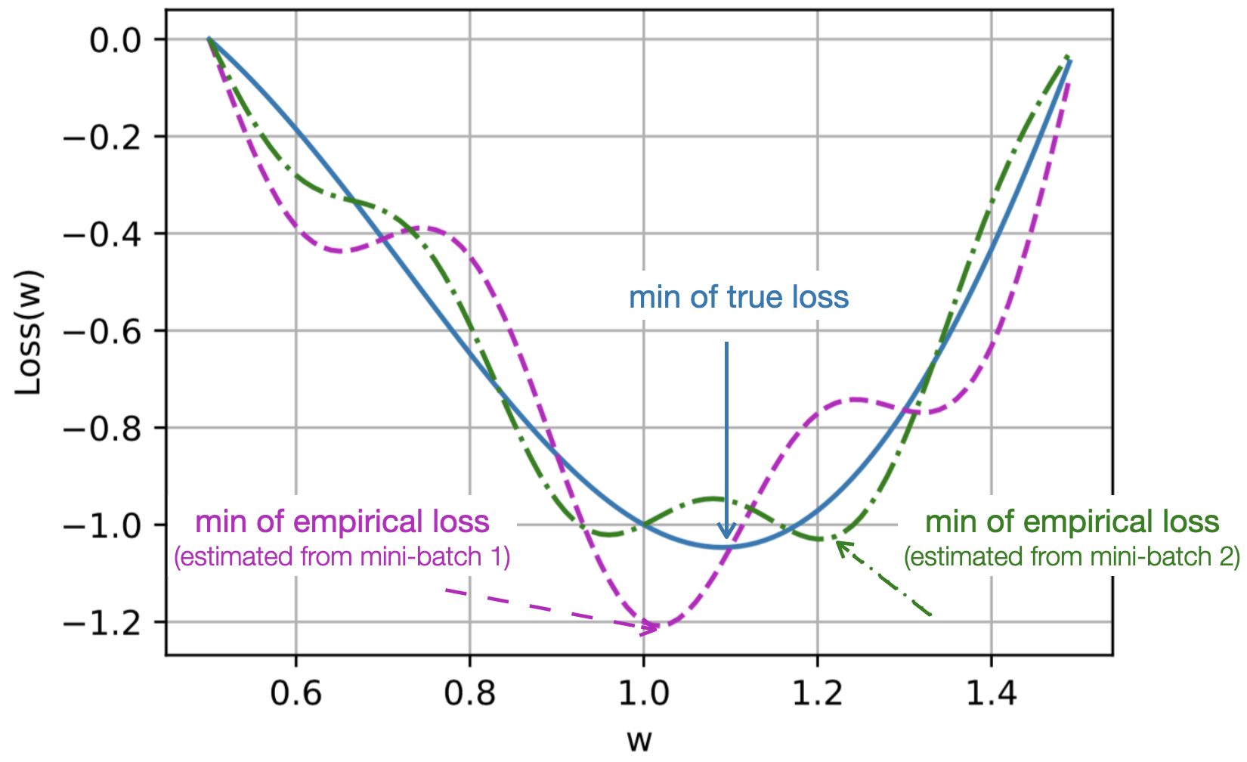
Batch Size
Usually chosen based on processor memory
Large batch size: more stable but less efficient (trends like full-batch)
Small batch size: more efficient but noisy (trends like stochastic)
  However, better generalization
  More likely to choose wide, flat region than sharp minimum

